Slide 1
Virtual-Memory Management
Benefits of Virtual Memory
Demand Paging
Principle of Working-set Model
Shared memory and Memory-mapped files
How to manage Kernel memory

Slide 2

Basic Page Replacement
If no frame is free, select a frame that is not currently in use
Write its contents to swap space and change the contents of the page table
Page fault-service routine should include the page replacement step
Two page transfers are done if no frame is free
Page-fault service time doubles
Modify or dirty bit can be used to improve the page-fault service time
The same principle can be applied for read- only pages

Slide 3
Basic Page Replacement
Page replacement is basic to demand paging
There are two issues that need to be resolved
Selection of a frame-allocation algorithm
How many frames to allocate to each process?
Selection algorithm for a page to be replaced
How to select a particular page replacement algorithm?
Evaluate an algorithm by taking a reference string and computing the number of page faults
String of memory references while executing a process is referred to as the reference string

Slide 4
Basic Page Replacement
How to generate a reference string?
Generate memory references artificially
Trace a given system and record all memory references
A large amount of data is produced
Two facts can be used to reduce amount of data
For a given page size, consider only the page number
If reference is made to a page p, immediately following references to the same page will never cause a page fault
Example addresses converted to a reference string
Number of page fault decreases with the increase in the number of allocated frames

Slide 5

Address sequence converted to a reference string
Notes:
5
100 bytes per page

Slide 6
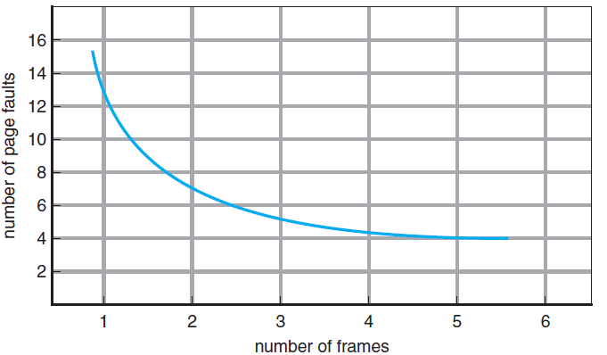
Graph of Page Faults Versus The Number of Frames
Notes:
6

Slide 7
FIFO Page Replacement
The simplest page-replacement algorithm
Associates with each page the time when that page was brought into memory
The oldest page is chosen for replacement
A FIFO queue can be used to serve the same purpose
Example reference string and the corresponding page faults
Performance of FIFO algorithm is not always good
A heavily used page may be replaced
The algorithm suffers from Belady’s anomaly
Consider the reference string
1, 2, 3, 4, 1, 2, 5, 1, 2, 3, 4, 5
The number of page faults increase with the increase in the number of allocated frames

Slide 8
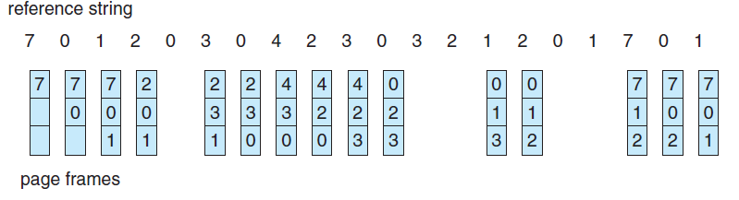
FIFO Page Replacement
Notes:
8

Slide 9
Reference String
Notes:
9

Slide 10
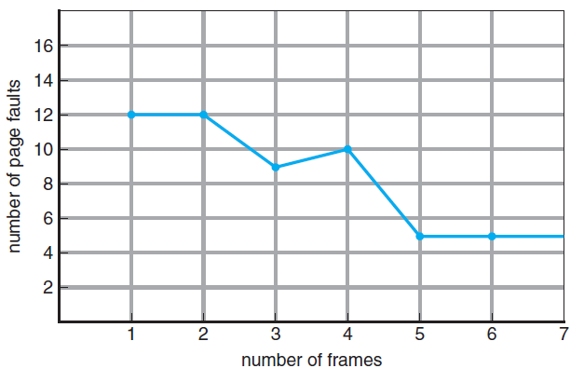
FIFO Illustrating Belady’s Anomaly
Notes:
10

Slide 11
Optimal Page Replacement
This page replacement algorithm has the lowest page-fault rate of all algorithms
It is called OPT or MIN algorithm
Replace the page that will not be used for the longest period of time
Guarantees the lowest possible page-fault rate for a fixed number of frames
Examples reference string and number of page faults
Difficult to implement
Requires future knowledge of the reference string
This algorithm is used mainly for comparison studies

Slide 12
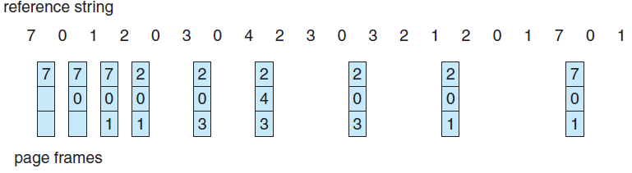
Optimal Page Replacement
Notes:
12

Slide 13
LRU Page Replacement
Replace the page that has not been used for the longest period of time
Least-recently-used page
OPT algorithm looks forward in time
Associate the time of last reference with each page
LRU applied on the reference string
Algorithm that is used to give a good overall performance
Major problem is how to implement the algorithm?
Determine an order for the frames defined by the time of last use
Two implementations are feasible

Slide 14
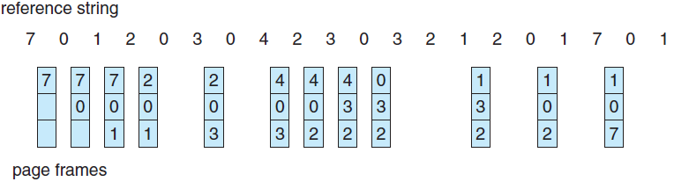
LRU Page Replacement
Notes:
14

Slide 15
LRU Page Replacement
Use of logical clock or counter with the CPU
Time of use field with each page table entry
Use of stack
Counters
Associate with each page-table entry a time-of-use field and add a counter or logical clock with the CPU
Working of the scheme
Scheme requires the search of the entire page table
Time must be maintained when page tables are changed
Overflow of the clock must be considered

Slide 16
LRU Page Replacement
Stack
Keep a stack of page numbers
Reference to a page would put its entry on top
Implement as a doubly linked list with a head and a tail pointer
Search of entire table is not required
Approach is appropriate for software or microcode implementation of LRU replacement
OPT and LRU do not suffer from Belady’s anomaly
Both belong to the class of stack algorithms
The set of pages in memory for n frames is always a subset of the set of pages that would be in memory with n+1 frames
Support of hardware is necessary for either implementation of LRU

Slide 17
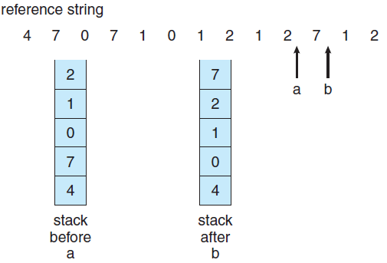
Use Of A Stack to Record The Most Recent Page References
Notes:
17

Slide 18
LRU-Approximation Page Replacement
Very few computer systems provide hardware support for implementing LRU algorithm
Other page replacement algorithms are used
Reference bit may be provided with each entry in the page table
Initially all bits are 0
The bit is set if a page is used at least once since it was brought into memory
Order of use is not recorded
Information is used in many page-replacement algorithms that approximate LRU
Additional-Reference-Bits Algorithm
Additional ordering information can be recorded by keeping more bits

Slide 19
LRU-Approximation Page Replacement
A byte is kept for each entry in the page table in a shift register
Working of the scheme
Page with the lowest number is the LRU page
If there are zero additional bits
The algorithm is called second-chance page- replacement algorithm
Second-Chance Algorithm
Select the FIFO page and inspect the reference bit
If reference bit is 0, proceed with the replacement
If reference bit is 1, give this page a second chance

Slide 20
LRU-Approximation Page Replacement
A page is given second chance by clearing its reference bit and resetting the arrival time to the current time
Implement by using a circular queue
A pointer indicates which page should be replaced next
Second-chance replacement degenerates to FIFO if all bits are set
Enhanced Second-Chance Algorithm
Consider the reference bit and modify bit as an ordered pair
There are four possible classes
1. (0,0) Neither recently used nor modified
Best page to replace

Slide 21
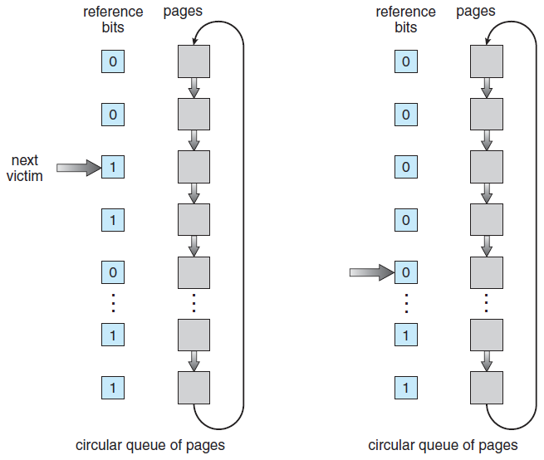
Second-Chance (clock) Page-Replacement Algorithm
Notes:
21

Slide 22
LRU-Approximation Page Replacement
2. (0,1) Not recently used but modified
Not a good choice for replacement
Page needs to be written to disk
3. (1,0) Recently used but clean
May be used again soon
4. (1,1) Recently used and modified
May be used again soon
Page has to be written to the disk
Replace the first page encountered in the lowest nonempty class
Circular queue may be scanned several times before the page is found
Modified pages are favored to reduce the I/O

Slide 23
Counting-Based page Replacement
Keep count of number of references to each page
Two schemes can be developed
Least frequently used (LFU) replacement algo.
Page with the smallest count is replaced
Problem
A page heavily used during initial phase but not used again will not be replaced
Shift the count right by one bit at regular intervals
Most frequently used (MFU) replacement algo.
Page with the smallest count was just brought in and has yet to be used
Implementation of both the above is expensive
They do not approximate OPT replacement well

Slide 24
Page-Buffering Algorithms
Optimizations are added to the replacement algorithms
Read the desired page first into a free frame before writing the victim page having Mbit=1
System keeps a pool of free frames
Maintain a list of modified pages
When paging device is idle, a modified page is written to the disk and M bit is reset
Keep a record of the contents of free frame list
Old page can be read directly from the free frames if needed
Some versions of UNIX uses this scheme with second-chance replacement algorithm
Can be used with any replacement algorithm

Slide 25
Applications and Page Replacement
Applications may use their own buffering mechanism
They perform badly if the OS-based scheme is also used
LRU may not work well for most of data warehousing applications – MFU may be better
Some OS provide raw disk ability to application programs
Ability to use a disk partition as a large sequential array of logical blocks
I/O to this array is termed as raw I/O
Bypasses all the file-system services
Most applications perform better when regular file-system services are used

